Slide 1

Searching Techniques: Concept of Search
Data Structure | Searching and Sorting
Course: Data Structure | Chapter: Searching and Sorting | Program: Bachelor of Engineering | Institution: Chandigarh University
DISCOVER · LEARN · EMPOWER
Notes:
Welcome everyone to today's lecture on Data Structures. We are focusing on Unit-3, specifically the fundamental concept of searching. As we begin, remember that efficient searching is the backbone of almost every software application you will build. Let us dive into how we locate data effectively.

Slide 2
Course Outcomes
SLIDE 2 / 10
Course Outcome
CO | BT LEVEL | DESCRIPTION
CO1 | BT1 | Understand and apply basic data structures, algorithms, complexity analysis, ADTs, arrays and linked lists.
CO2 | BT2 | Apply and implement stacks and queues in problem-solving.
CO3 | BT3 | Analyse and apply searching, sorting, and hashing techniques.
CO4 | BT4 | Construct and apply tree structures and traversal techniques.
CO5 | BT5 | Represent and solve graph problems using DFS, BFS, and graph algorithms.
Chandigarh University
2 / 10
Notes:
Today's session directly addresses two specific Course Outcomes. First, we will analyze how to apply searching techniques to solve problems, which is CO3. Second, we will see how these concepts lay the groundwork for constructing tree structures, linking to CO4. These outcomes ensure you can both analyze and construct data solutions.

Slide 3
Learning Objectives
SLIDE 3 / 10
Learning Outcomes
1
Define the core concept of searching and its primary goal.
2
Analyze the difference between sequential and binary search methods.
3
Evaluate the time complexity of linear search algorithms.
4
Apply search logic to find elements in sorted arrays.
Chandigarh University
3 / 10
Notes:
By the end of this lecture, you will be able to define exactly what a search operation entails. You will analyze why we need different methods for different data types. We will evaluate how fast these methods run using time complexity. Finally, you will apply this logic to find specific items in a list.

Slide 4
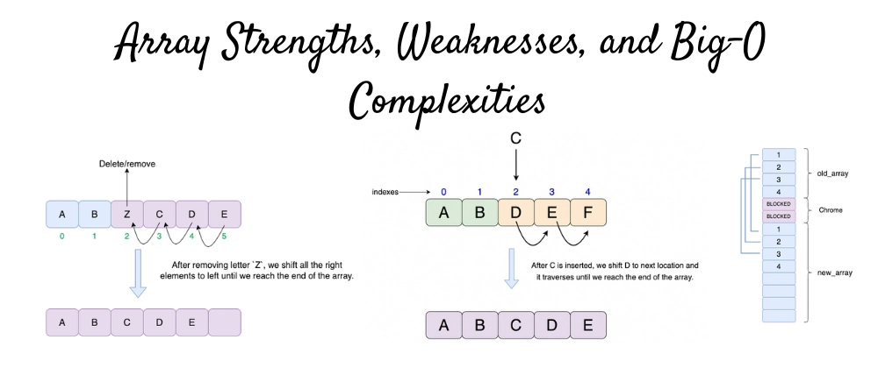
Lecture
SLIDE 4 / 10
Definition of Search Operation
1
Searching is the process of locating a specific key within a collection.
2
The collection is typically an array, list, or database table.
3
The goal is to return the index or address of the key.
4
If the key is not found, the algorithm returns a failure signal.
5
Search efficiency depends on the data size and organization.
Array Strengths, Weaknesses, Insertion & Deletion Algorithms With Big-O - DEV Community
Chandigarh University
4 / 10
Notes:
Think of searching like looking for a specific book in a library. The library is your data collection, and the book title is your key. The process involves checking items one by one or using a system to locate the exact shelf. If the book is missing, the librarian tells you it is not available.

Slide 5
Lecture
SLIDE 5 / 10
Linear Search Mechanism
1
Linear search checks every element sequentially from the start.
2
It works on both sorted and unsorted data collections.
3
The algorithm stops immediately upon finding a matching key.
4
Worst-case scenario requires checking all n elements in the list.
5
Best-case scenario finds the element at the very first position.
Chandigarh University
5 / 10
Notes:
Linear search is the most straightforward method, similar to reading a list from top to bottom. Imagine you are checking a queue of students for a specific name. You start at the front and move down until you find the match. If the name is at the very end, you have to check everyone.

Slide 6
Lecture
SLIDE 6 / 10
Time Complexity Analysis
1
Best case time complexity is O(1) when the key is first.
2
Average case time complexity is O(n) for random data.
3
Worst case time complexity is O(n) when the key is last.
4
Space complexity is O(1) as no extra memory is required.
5
Performance degrades linearly as the list size increases significantly.
Chandigarh University
6 / 10
Notes:
Let's look at the math behind the speed. If you find the item immediately, it takes constant time, which is O(1). However, if the item is at the very end, you perform n comparisons. This means if you double the list size, you roughly double the time taken. This linear relationship is crucial for large datasets.

Slide 7
Lecture
SLIDE 7 / 10
Binary Search Requirement
1
Binary search requires the data to be sorted in ascending order.
2
It compares the key with the middle element of the list.
3
It eliminates half of the remaining elements in each step.
4
The search range is updated to the left or right half.
5
This method is significantly faster than linear search for large lists.
Chandigarh University
7 / 10
Notes:
Binary search is like looking up a word in a dictionary. You do not start from page one; you open the middle. If the word you want comes before the middle word, you ignore the second half. This halving process continues until you find the word or run out of pages.

Slide 8
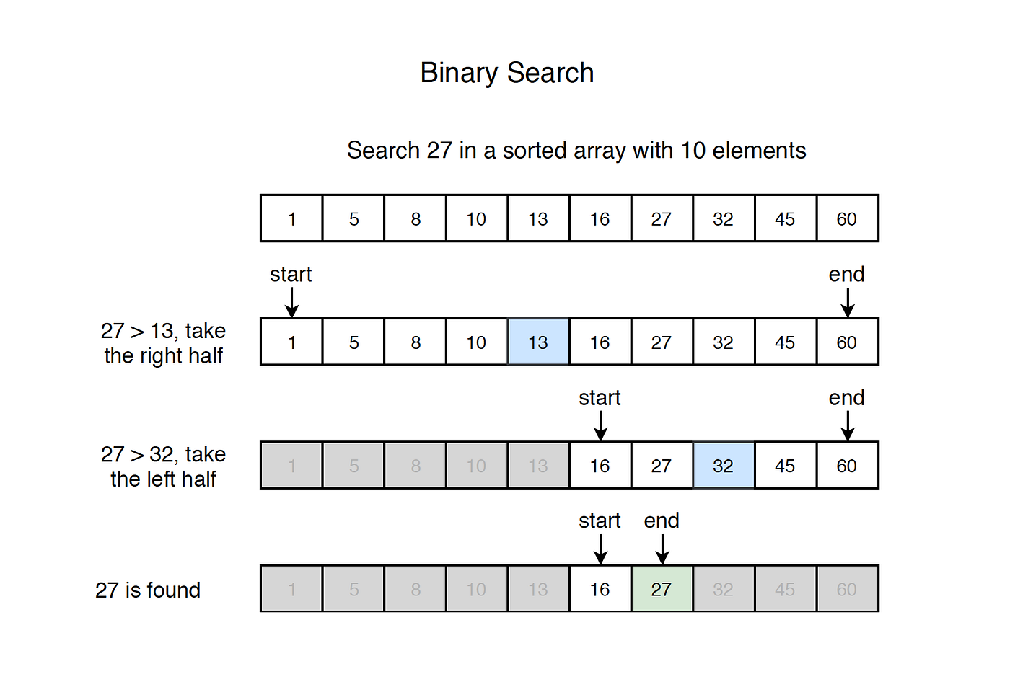
Lecture
SLIDE 8 / 10
Worked Numerical Example
ARRAY
[10, 20, 30, 40, 50, 60, 70, 80, 90, 100]
TARGET KEY
70
STEP 1
Middle index is 5, value is 60 (60 < 70).
STEP 2
Search right half [70, 80, 90, 100], new middle is 70.
RESULT
Key found at index 6 after 2 comparisons.
Source: miro.medium.com
Chandigarh University
8 / 10
Notes:
Let's trace this with a real example. We have a sorted list of ten numbers. We want to find 70. First, we check the middle, which is 60. Since 70 is larger, we discard the left half. Now we look at the right half, find the new middle, and there it is. We found it in just two steps.

Slide 9
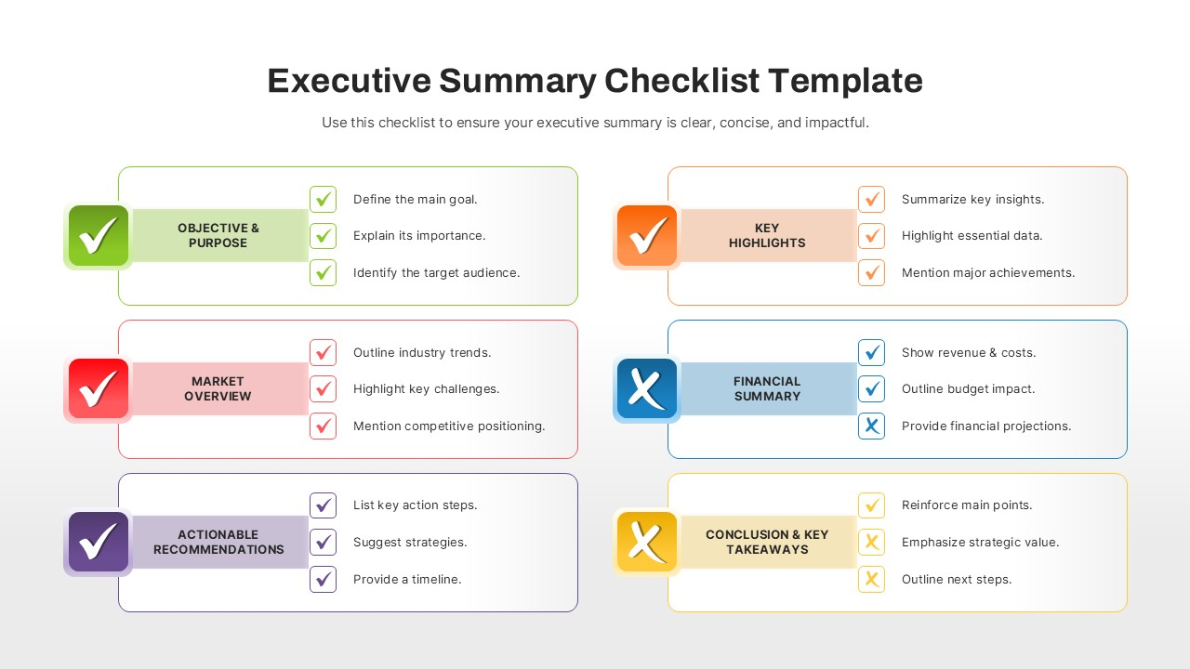
Lecture
SLIDE 9 / 10
Key Takeaways
1
Searching locates a specific key within a data collection efficiently.
2
Linear search is simple but slow for large unsorted datasets.
3
Binary search is fast but strictly requires sorted data input.
4
Time complexity determines the scalability of the search algorithm.
5
Choosing the right technique depends on data organization and size.
Source: www.slidekit.com
Chandigarh University
9 / 10
Notes:
To summarize, searching is about finding data efficiently. Linear search is your go-to for unsorted data, while binary search is superior for sorted lists. Remember that the speed of your algorithm depends heavily on how the data is organized. Always choose the method that fits your data structure.

Slide 10
Lecture
SLIDE 10 / 10
References
DATA STRUCTURES
A Pseudocode Approach with C — Gilberg, Forouzan
• Data Structures — Lipschutz
• Data Structure Using C — AK Sharma
• C and Data structure — P. S. Deshpandey
Chandigarh University
10 / 10
Notes:
For further reading and deeper understanding, please refer to these standard textbooks. Gilberg and Forouzan provide excellent pseudocode approaches. Lipschutz and Sharma offer clear C implementations. Deshpandey is also a great resource for practical examples. Thank you for your attention.

